Slide 1

Minicurso Bioinformática
Prof. Dr. Diego M. Riaño-Pachón

Slide 2
Part III
Bioinformatics and Genomics
Prof. Dr. Diego Mauricio Riaño-Pachón
Laboratório de Biologia Computacional, Evolutiva e de Sistemas
Centro de Energia Nuclear na Agricultura
Universidade de São Paulo
Piracicaba, Brasil
diego.riano@cena.usp.br

Slide 3
Minicurso Bioinformática
Part I - Intro to bioinformatics, main databases and sequence similarity
Part II – Bioinformatics tools for the identification of organisms using sequence data
Part III – Bioinformatics applied to genomics

Slide 4
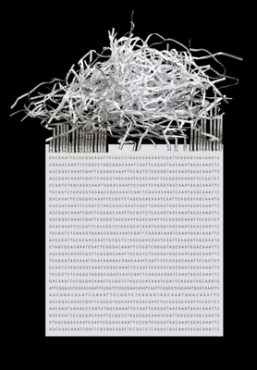
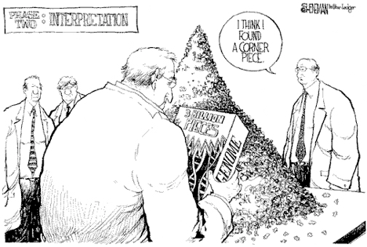
Genome assembly
X

Slide 5
de novo Genome assembly
Why?
No references available. You are the only one studying that bug!
The references available might not be the best one
pan genome vs core genome
species definition

Slide 6
Sequencing technologies

Slide 7

Next Generation Sequencing: Technologies and applications
Single Molecule Real Time Sequencing (SMRT)

Slide 8
PacBio: Single Molecule Real Time Sequencing (SMRT)
Play Video
https://www.youtube.com/watch?v=v8p4ph2MAvI

Slide 9
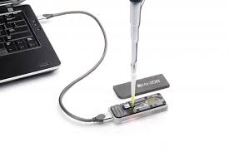

Next Generation Sequencing: Technologies and applications
Nanopore sequencing

Slide 10
Oxford Nanopore
Play Video
https://www.youtube.com/watch?v=CGWZvHIi3i0

Slide 11

Next Generation Sequencing: Technologies and applications
Sequencing by Synthesis

Slide 12
Illumina: Sequencing by synthesis
Play Video
https://www.youtube.com/watch?v=HMyCqWhwB8E

Slide 13
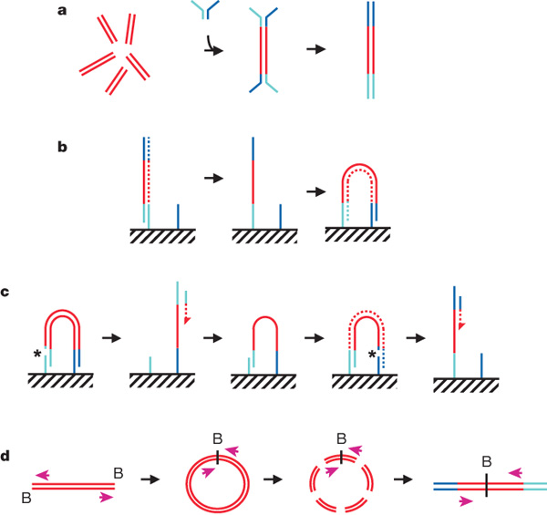
Illumina: Overview
Mate pair sequencing
Long fragments, e.g., 10Kbp
Circularize
Fragment
Ligate Y adapters
Bentley et al. 2008. Nature 456, 53-59 | doi:10.1038/nature07517
Notes:
a, DNA fragments are generated, for example, by random shearing and joined to a pair of oligonucleotides in a forked adaptor configuration. The ligated products are amplified using two oligonucleotide primers, resulting in double-stranded blunt-ended material with a different adaptor sequence on either end. b, Formation of clonal single-molecule array. DNA fragments prepared as in a are denatured and single strands are annealed to complementary oligonucleotides on the flow-cell surface (hatched). A new strand (dotted) is copied from the original strand in an extension reaction that is primed from the 3' end of the surface-bound oligonucleotide; the original strand is then removed by denaturation. The adaptor sequence at the 3' end of each copied strand is annealed to a new surface-bound complementary oligonucleotide, forming a bridge and generating a new site for synthesis of a second strand (dotted). Multiple cycles of annealing, extension and denaturation in isothermal conditions result in growth of clusters, each approx1 mum in physical diameter. This follows the basic method outlined in ref. 33. c, The DNA in each cluster is linearized by cleavage within one adaptor sequence (gap marked by an asterisk) and denatured, generating single-stranded template for sequencing by synthesis to obtain a sequence read (read 1; the sequencing product is dotted). To perform paired-read sequencing, the products of read 1 are removed by denaturation, the template is used to generate a bridge, the second strand is re-synthesized (shown dotted), and the opposite strand is then cleaved (gap marked by an asterisk) to provide the template for the second read (read 2). d, Long-range paired-end sample preparation. To sequence the ends of a long (for example, >1 kb) DNA fragment, the ends of each fragment are tagged by incorporation of biotinylated (B) nucleotide and then circularized, forming a junction between the two ends. Circularized DNA is randomly fragmented and the biotinylated junction fragments are recovered and used as starting material in the standard sample preparation procedure illustrated in a. The orientation of the sequence reads relative to the DNA fragment is shown (magenta arrows). When aligned to the reference sequence, these reads are oriented with their 5' ends towards each other (in contrast to the short insert paired reads produced as shown in a–c). See Supplementary Fig. 17a for examples of both. Turquoise and blue lines represent oligonucleotides and red lines represent genomic DNA. All surface-bound oligonucleotides are attached to the flow cell by their 5' ends. Dotted lines indicate newly synthesized strands during cluster formation or sequencing. (See Supplementary Methods for details.)

Slide 14
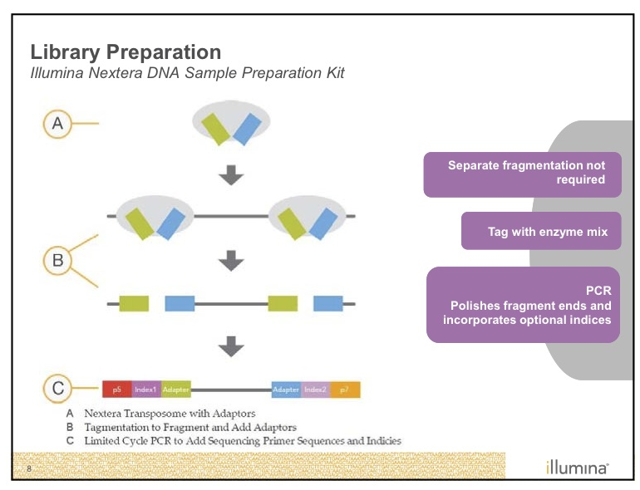
Illumina: Library preparation NeXtera

Slide 15
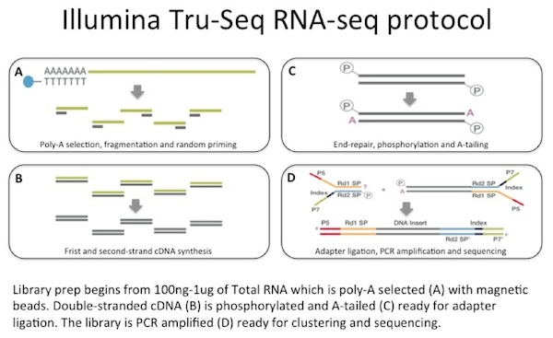
Illumina: Library preparation TruSeq RNASeq

Slide 16
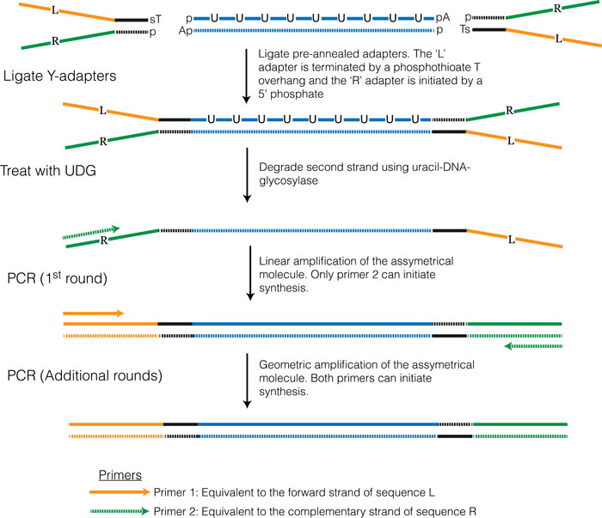
Illumina: Library preparation TruSeq Strand-specific RNASeq

Slide 17
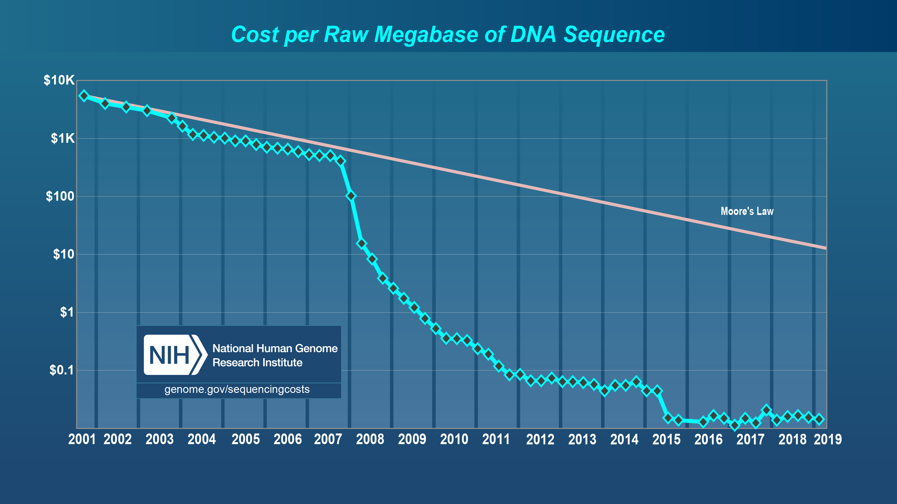
Sequencing costs
http://www.genome.gov/sequencingcosts/
Notes:
Moore's law describes a long-term trend in the history of computing hardware. The number of transistors that can be placed inexpensively on an integrated circuit doubles approximately every two years.[1] This trend has continued for more than half a century and is expected to continue until 2015 or 2020 or later.[2]

Slide 18
Applications

Slide 19
Genome sequencing
Panda
Octopus
1000 human genomes
1001 Arabidopsis genomes
10K Vertebrate genomes
Genomic Encyclopedia of Bacteria and Archaea
Community Genomics: Metagenomics

Slide 20
Genome Assembly

Slide 21
¿How do you get the genome sequence of an organism?
Example: imagine a genome of size 10bp, you have three copies, each copy get fragmented in the following way, you do not know the order of the fragments:
TG, ATG y CCTAC
AT, GCC y TACTG
CTG, CTA y ATGC
¿Which is the original genome sequence?
CCTAC
CCTAC
GCCTACTG
CTACTG
CC
TAC
C
CTA
ATGCCTACTG
Notes:
ATGCCTACTG

Slide 22
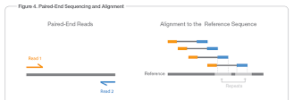
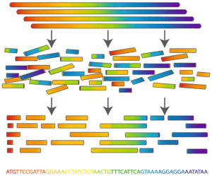
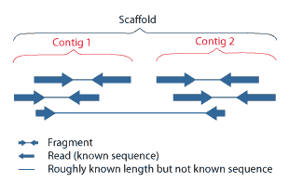
de novo Genome assembly: concepts
Yesterday we talked about types of reads, let’s see how they work to get a genome assembly
Each fragment can be sequence form any end. Preferentially from both: paired-end sequencing
Paired-ends
Mate pairs

Slide 23
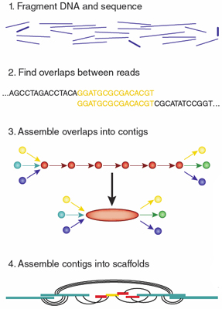
de novo Genome assembly: concepts
Typically 200-400bp
How?
Assemblers!
Scaffoldings: use reference, use mate-pairs
http://www.nature.com/nmeth/journal/v9/n4/full/nmeth.1935.html

Slide 24
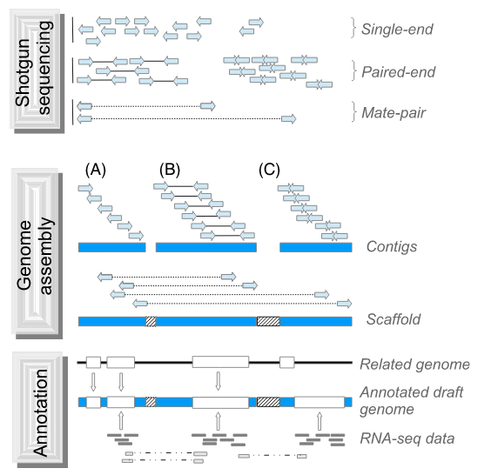
de novo Genome assembly: concepts
http://onlinelibrary.wiley.com/doi/10.1111/eva.12178/full

Slide 25
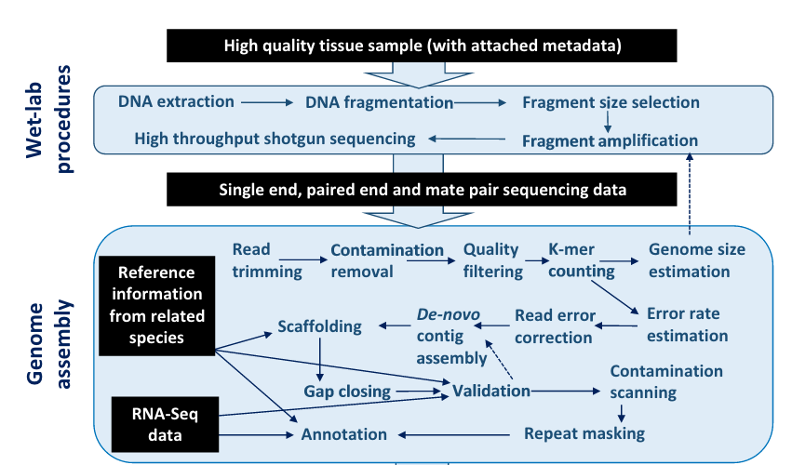
de novo Genome assembly: Overview
Ekblom & Wolf, 2014. http://onlinelibrary.wiley.com/doi/10.1111/eva.12178/full

Slide 26
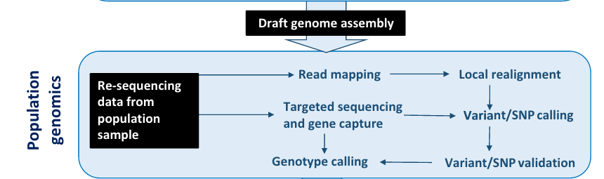
de novo Genome assembly: Overview
Ekblom & Wolf, 2014. http://onlinelibrary.wiley.com/doi/10.1111/eva.12178/full

Slide 27
de novo Genome assembly: Wet-lab Effort
How much data to generate?
How many reads do I need?
Ekblom & Wolf, 2014. http://onlinelibrary.wiley.com/doi/10.1111/eva.12178/full

Slide 28
de novo Genome assembly: Wet-lab Effort
How much data to generate?
How many reads do I need?
The goal: generate robust scientific findings with the lowest sequencing cost
Coverage!
What is coverage?
Sims et al, 2014. http://www.nature.com/nrg/journal/v15/n2/full/nrg3642.html

Slide 29
de novo Genome assembly: Concepts
Coverage!
“The expected coverage is the average number of times that each nucleotide is expected to be sequenced given a certain number of reads of a given length and the assumption that reads are randomly distributed across an idealized genome”
Also called depth or depth of coverage
Genome sequence
Coverage
4
0
1
2
3
2
3
Sims et al, 2014. http://www.nature.com/nrg/journal/v15/n2/full/nrg3642.html

Slide 30
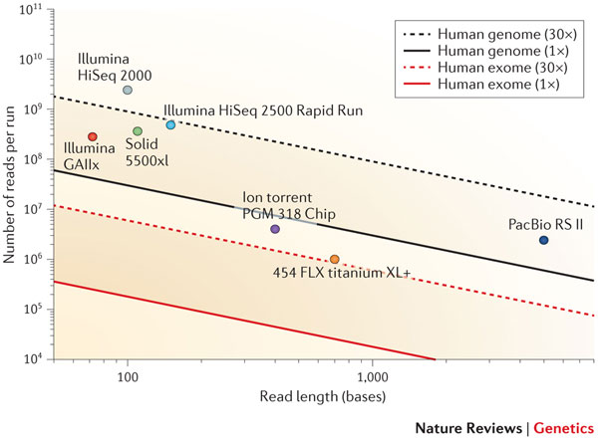

de novo Genome assembly: Coverage Sanger vs NGS
Theoretical coverage according to the Lander-Waterman formula for the human genome and exome sequencing
Why?
Typical Coverage
Sanger
Illumina
8-10
50-100
Lander and Waterman, 1988
Coverage=
Read length x Number of reads
Genome size
Probability that a base is sequenced Y times:
Sims et al, 2014. http://www.nature.com/nrg/journal/v15/n2/full/nrg3642.html
Lander & Waterman, 1988. http://www.ncbi.nlm.nih.gov/pubmed/3294162
http://www.illumina.com/documents/products/technotes/technote_coverage_calculation.pdf
Notes:
Why: Sanger has usually longer reads, coming from libraries with longer inser sizes, and software for sanger-based assemblies is usually more mature.

Slide 31
de novo Genome assembly: Coverage NGS
Probability that a base is sequenced Y times:
Compute the probability that a base is sequenced 4 times if you have a coverage of 5
Compute the probability that a base is sequenced at most 4 times if you have a coverage of 5
Compute the probability that a base is sequenced at least 4 times if you have a coverage of 5
You can interpret the second probability as the proportion of bases that will be covered by 4 or less reads
Sims et al, 2014. http://www.nature.com/nrg/journal/v15/n2/full/nrg3642.html
Lander & Waterman, 1988. http://www.ncbi.nlm.nih.gov/pubmed/3294162
http://www.illumina.com/documents/products/technotes/technote_coverage_calculation.pdf
Notes:
For the first question answer: 0.175
For the second question you should use P(Y<=4)=P(Y=4)+P(Y=3)+P(Y=2)+P(Y=1)+P(Y=0)
Answer: 0.44 or 44% of the bases would be sequenced 4 times or less
For the third question, compute P(Y<=3) and then take than and subtract from 1:
Answer: 73% of the bases will be sequenced at least 4 times

Slide 32
de novo Genome assembly: Coverage Illumina
Use the Illumina Coverage calculator and compute:
Number of bacterial species with genome size of 5Mbp that you could sequence at a coverage of 50x on a
MiSeq V3 reagents
MiSeq V2 reagents
MiSeq v2 Nano
HiSeq 2500 Rapid Run with cBot
Number of plant genomes with genome size of 400Mbp that you could sequence at a coverage of 50x on a
MiSeq V3 reagents
MiSeq V2 reagents
MiSeq v2 Nano
HiSeq 2500 Rapid Run with cBot
HiSeq 2500 High Output
http://support.illumina.com/downloads/sequencing_coverage_calculator.html
Notes:
For the first question answer: 0.175
For the second question you should use P(Y<=4)=P(Y=4)+P(Y=3)+P(Y=2)+P(Y=1)+P(Y=0)
Answer: 0.44 or 44% of the bases would be sequenced 4 times or less
For the third question, compute P(Y<=3) and then take than and subtract from 1:
Answer: 73% of the bases will be sequenced at least 4 times

Slide 33
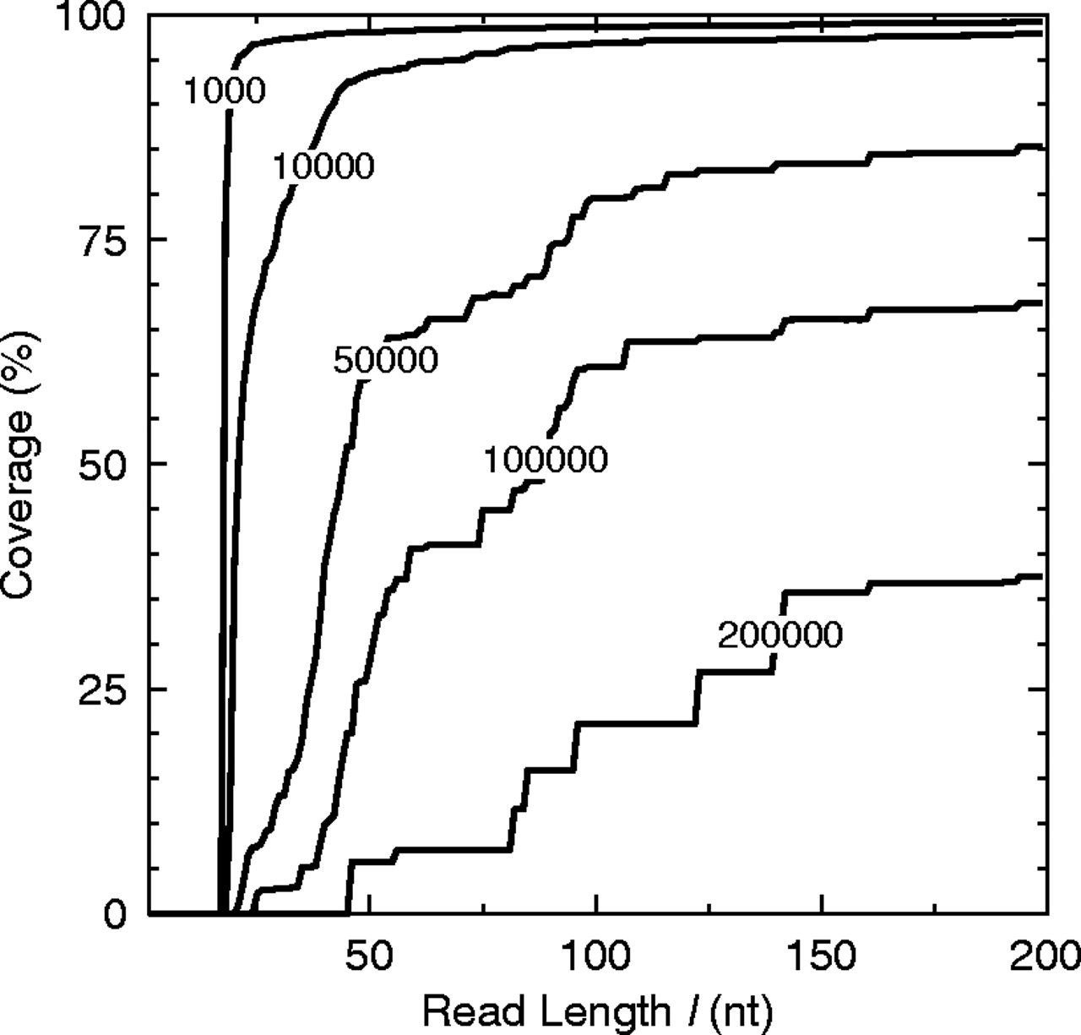
Effect of read length on breath of coverage
Percentage of the E.coli genome recovered by contigs greater than a threshold length as a function of read length.
Whiteford, et al., 2005. http://nar.oxfordjournals.org/content/33/19/e171.full

Slide 34
After all that you have decided how much data you need, you have paid your sequence provider, send your sample and should have now some nice clean reads.
Let’s see how to do a de novo genome assembly

Slide 35
de novo CONTIG assembly: Overview
“An assembly is a hierarchical data structure that maps the sequence data to a putative reconstruction of the target. It groups reads into contigs and contigs into scaffolds.”
From small RANDOMLY located
sequence fragments
Consensus, contiguous sequences
Miller et al., 2010. http://www.sciencedirect.com/science/article/pii/S0888754310000492

Slide 36
Methods for de novo genome assembly
Overlap-Layout- Consensus: OLC
De Bruijn Graphs
These two use graph theory to face the problem of genome assembly. The difference in on how you build the graph.

Slide 37
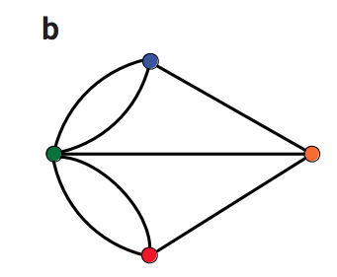
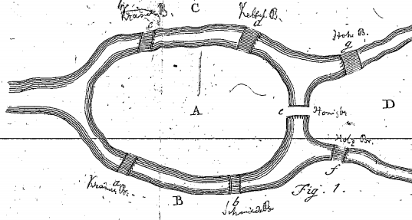
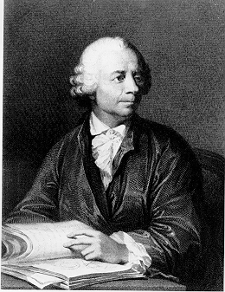
Basics of graph theory: a tale of bridges
Today: Kaliningrad, Russia
Seven Bridges of Königsberg: Is there walk through the city that would cross each bridge once and only once?
A graph
G={V,E}
Vertex
or node
Edge
Euler’s insights (1735):
The route inside each island is irrelevant
Only the sequence of bridges crossed is important
Leonard Euler
(1707-1783)
Basel, Switzerland
Simplify the problem
Compeau et al., 2011. http://www.nature.com/nbt/journal/v29/n11/full/nbt.2023.html
https://en.wikipedia.org/wiki/Seven_Bridges_of_K%C3%B6nigsberg
https://math.dartmouth.edu/~euler/docs/originals/E053.pdf
Notes:
From Wikipedia: The city of Königsberg in Prussia (now Kaliningrad, Russia) was set on both sides of the Pregel River, and included two large islands which were connected to each other and the mainland by seven bridges. The problem was to devise a walk through the city that would cross each bridge once and only once, with the provisos that: the islands could only be reached by the bridges and every bridge once accessed must be crossed to its other end. The starting and ending points of the walk need not be the same. The difficulty was the development of a technique of analysis and of subsequent tests that established this assertion with mathematical rigor.

Slide 38
Basics of graph theory: a tale of bridges
Seven Bridges of Königsberg
A graph
Except for the endpoints of the walk, each time one enters a node, one leaves that same node.
G={V,E}
Leonard Euler
3
If one has to traverse each bridge exactly one, then it follows that, except for start and finish, the number of bridges (edges) touching the land (nodes) must be even.
5
3
As all land masses have an odd degree, one cannot possibly traverse each bridge exactly once
3
Degree of a node: number of edges connected to the node
A necessary condition for the walk is that the graph must have exactly zero or two nodes of odd degree
https://en.wikipedia.org/wiki/Seven_Bridges_of_K%C3%B6nigsberg
https://math.dartmouth.edu/~euler/docs/originals/E053.pdf

Slide 39
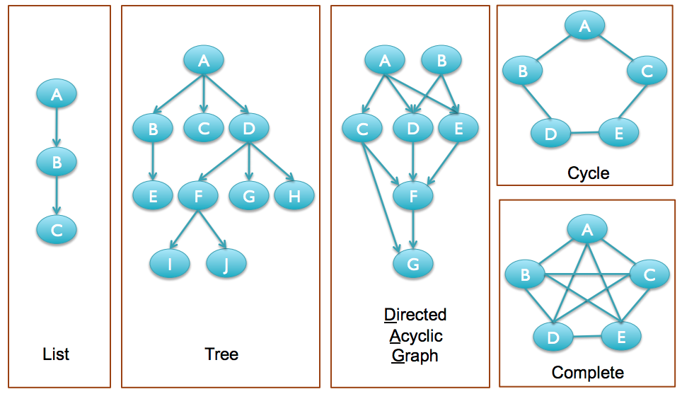
Types of graphs
Mention some examples of such graphs!
http://schatzlab.cshl.edu/teaching/2010/Lecture%203%20-%20Graphs%20and%20Genomes.pdf

Slide 40
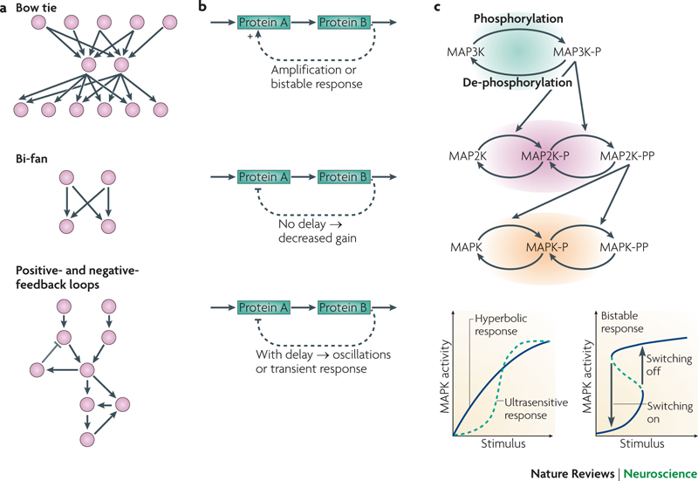
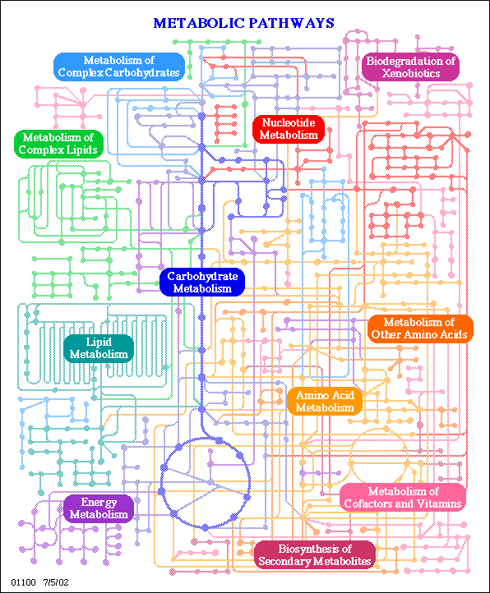
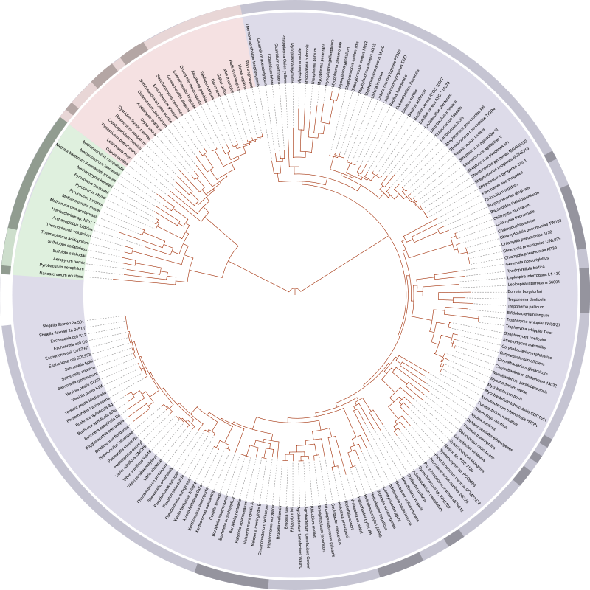
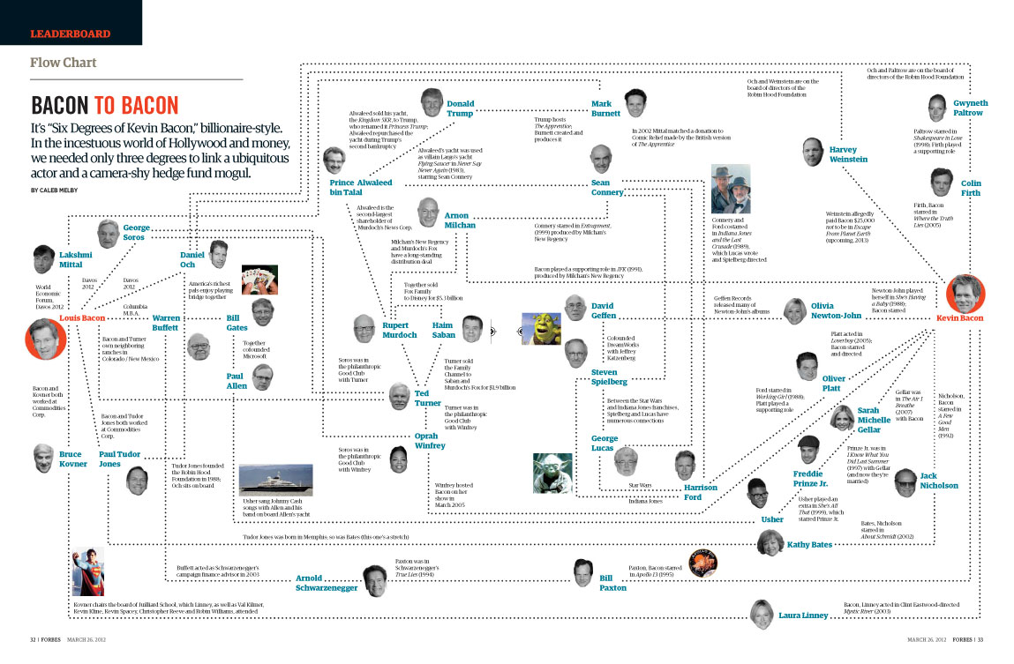
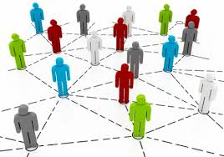
Graph theory in biology
Phylogenetic trees
Regulatory, signal transduction, metabolic networks
Social, epidemiological networks

Slide 41
Methods for de novo genome assembly
Overlap-Layout- Consensus: OLC
De Bruijn Graphs
These two use graph theory to face the problem of genome assembly. The difference in on how you build the graph.
Problem abstraction/representation

Slide 42
Overlap-Layout- Consensus: OLC
Overlap
Build overlap graph
Layout
Build contigs
Select likely nucleotide sequence for each contig
Consensus
http://www.cs.jhu.edu/~langmea/resources/lecture_notes/assembly_olc.pdf

Slide 43
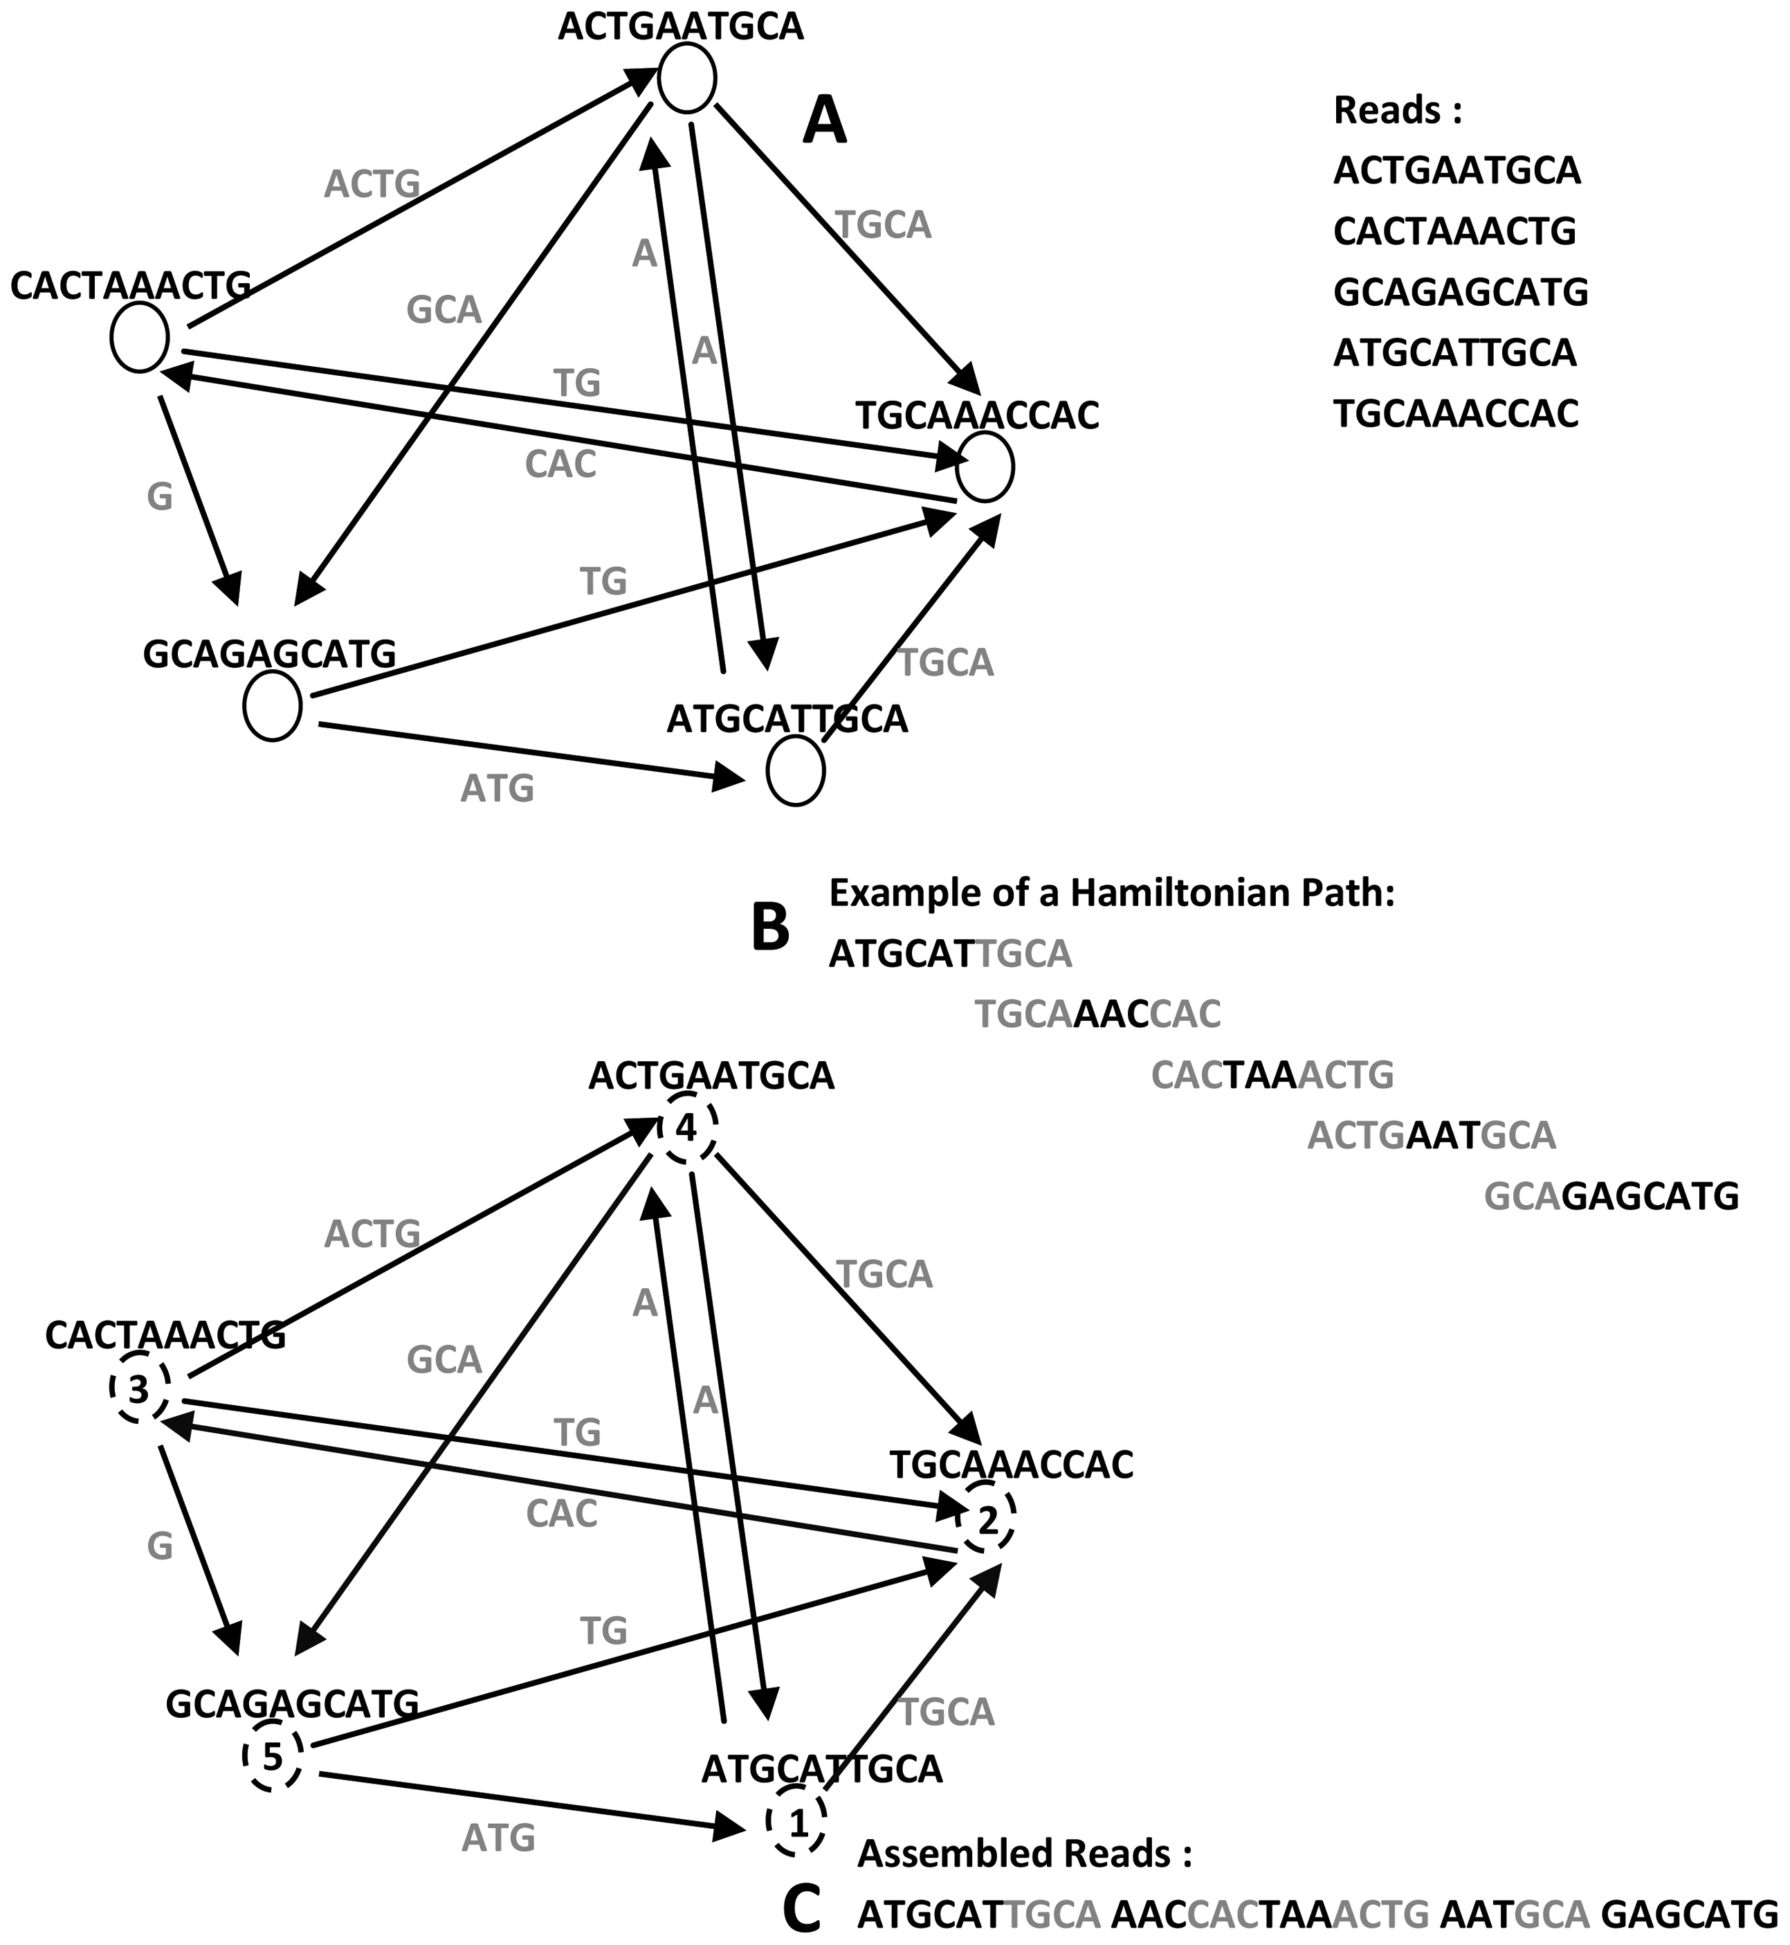
Overlap-Layout- Consensus: OLC
Overlap
Very simple task:
For each pair of reads, find overlap.
But it is very computationally demanding for large number of reads.
Reads are nodes, there is an edge between nodes if there is a suffix-prefix relationship among them
http://www.cs.jhu.edu/~langmea/resources/lecture_notes/assembly_olc.pdf
El-Metwally, et al., 2013. http://journals.plos.org/ploscompbiol/article?id=10.1371/journal.pcbi.1003345

Slide 44
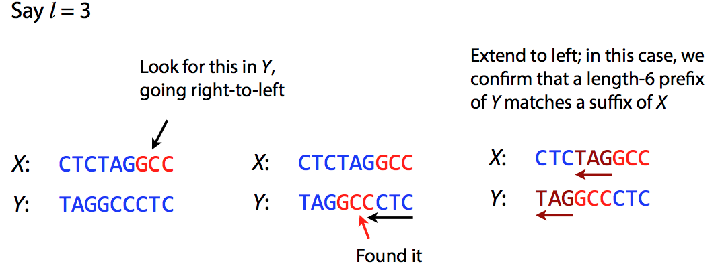
Overlap-Layout- Consensus: OLC
Overlap
How to compute the overlaps?
Naïve approach
Suffix to Prefix overlaps
Do this for each pair of reads!
http://www.cs.jhu.edu/~langmea/resources/lecture_notes/assembly_olc.pdf

Slide 45
Overlap-Layout- Consensus: OLC
How to compute the overlaps?
Overlap
Generalized Suffix Tree: A more efficient approach in most cases
Generalized suffix tree for { “GACATA”, “ATAGAC” } S=GACATA$₀ATAGAC$₁
$₀
C
$₁
GAC
TA
A
76
14
GAC$₁
$₁
$₁
GAC$₁
$₀
C
TA
ATA$₀
ATA$₀
$₀
66
106
36
136
16
116
5
96
$₁
ATA$₀
$₀
GAC$₁
Check that all suffixes are present in the tree
26
126
4
8
Where is query GACATA?
https://en.wikipedia.org/wiki/Suffix_tree
http://www.cs.jhu.edu/~langmea/resources/lecture_notes/assembly_olc.pdf
https://www.youtube.com/watch?v=VA9m_l6LpwI

Slide 46
Overlap-Layout- Consensus: OLC
How to compute the overlaps?
Overlap
Generalized Suffix Tree: A more efficient approach in most cases
Generalized suffix tree for { “GACATA”, “ATAGAC” } S=GACATA$₀ATAGAC$₁
$₀
C
$₁
GAC
TA
A
76
14
GAC$₁
$₁
$₁
GAC$₁
$₀
C
TA
ATA$₀
ATA$₀
$₀
66
106
36
136
16
116
5
96
$₁
ATA$₀
$₀
GAC$₁
GACATA
Blue edge implies length-3 suffix of second
string equals length-3 prefix of query
ATAGAC
26
126
4
8
https://en.wikipedia.org/wiki/Suffix_tree
http://www.cs.jhu.edu/~langmea/resources/lecture_notes/assembly_olc.pdf
https://www.youtube.com/watch?v=VA9m_l6LpwI

Slide 47
Overlap-Layout- Consensus: OLC
How to compute the overlaps?
Overlap
Generalized Suffix Tree: A more efficient approach
Generalized suffix tree for { “GACATA”, “ATAGAC” } S=GACATA$₀ATAGAC$₁
$₀
C
$₁
GAC
TA
A
76
14
GAC$₁
$₁
$₁
GAC$₁
$₀
C
TA
ATA$₀
ATA$₀
$₀
66
106
36
136
16
116
5
96
$₁
ATA$₀
$₀
GAC$₁
Now use ATAGAC as query
Which are the suffix-prefix alignments with GACATA?
26
126
4
8
https://en.wikipedia.org/wiki/Suffix_tree
http://www.cs.jhu.edu/~langmea/resources/lecture_notes/assembly_olc.pdf
https://www.youtube.com/watch?v=VA9m_l6LpwI

Slide 48
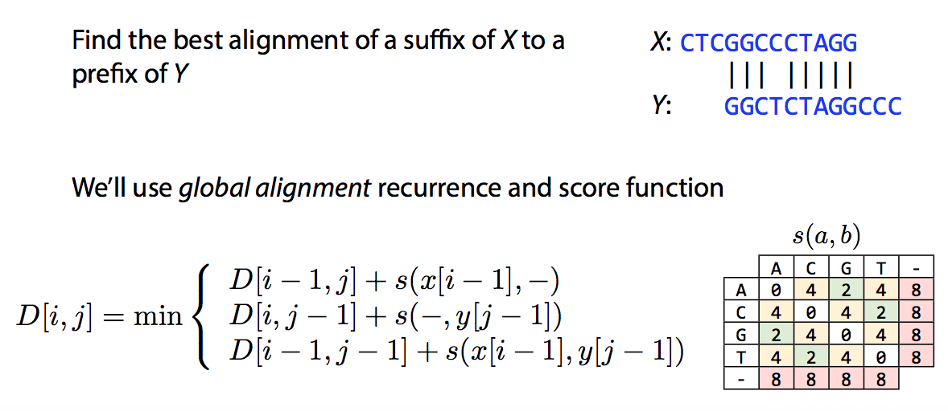
Overlap-Layout- Consensus: OLC
Overlap
How to compute the overlaps?
Dynamic programming
Dynamic programming is needed due to sequencing errors, e.g., indels or mismatches. First do suffix tree to reduce number of reads that should be aligned using dynamic programming, reduce tremendously the size of the problem.
http://www.cs.jhu.edu/~langmea/resources/lecture_notes/assembly_olc.pdf

Slide 49
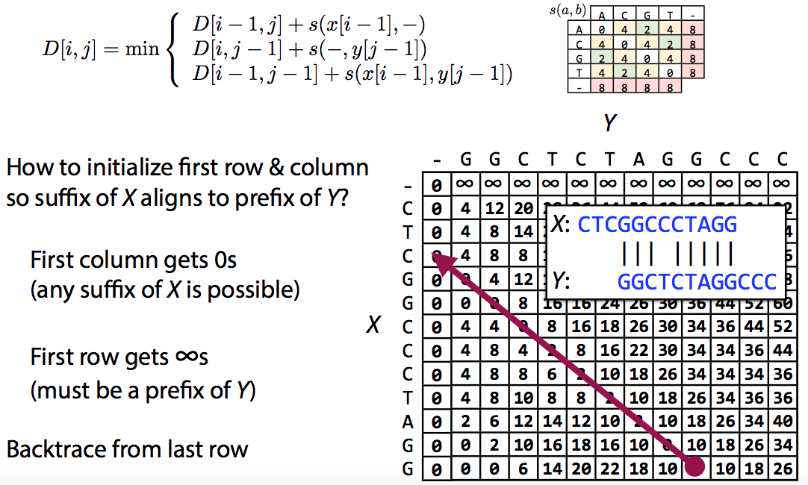
Overlap-Layout- Consensus: OLC
Overlap
How to compute the overlaps?
Dynamic programming
http://www.cs.jhu.edu/~langmea/resources/lecture_notes/assembly_olc.pdf

Slide 50
Dynamic Programing: Global Alignment
j
Gaps: λ= -6
Similarity matrix(σ): Match=+5; Mismatch=-2
Initialize (0,0)=0
 | - | A | C | A | C | T | A
-
A
G
C
A
C
A
C
A
 | 0
i
γ=gaps=-6
Filling in the cells:
Eddy SA. 2004. What is dynamic programming? Nature Biotech. 22:909-10.

Slide 51
`
j
 | - | A | C | A | C | T | A
- | 0 | -6 | -12
A | -6 | +5
G | -12
C
A
C
A
C
A
Match=5
Mismatch=-2
γ=-6
i

Slide 52
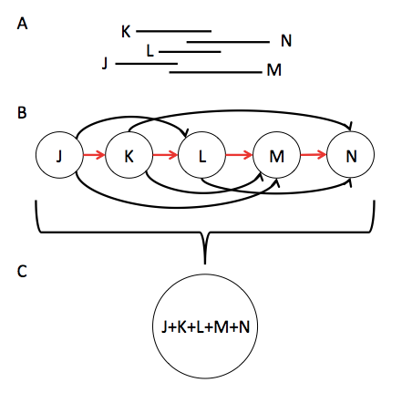
Overlap-Layout- Consensus: OLC
Layout
Select the path that visits every node, i.e., look for a Hamiltonian path in the graph
http://gcat.davidson.edu/phast/olc.html

Slide 53
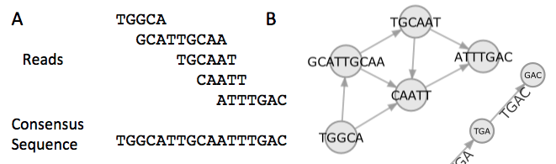
Overlap-Layout- Consensus: OLC
Layout
Select the path that visits every node exactly once, i.e., look for a Hamiltonian path in the graph
X
Overlap graph: Edge represent overlaps of 2 or more nt
Search for the hamiltonian path
http://gcat.davidson.edu/phast/olc.html

Slide 54
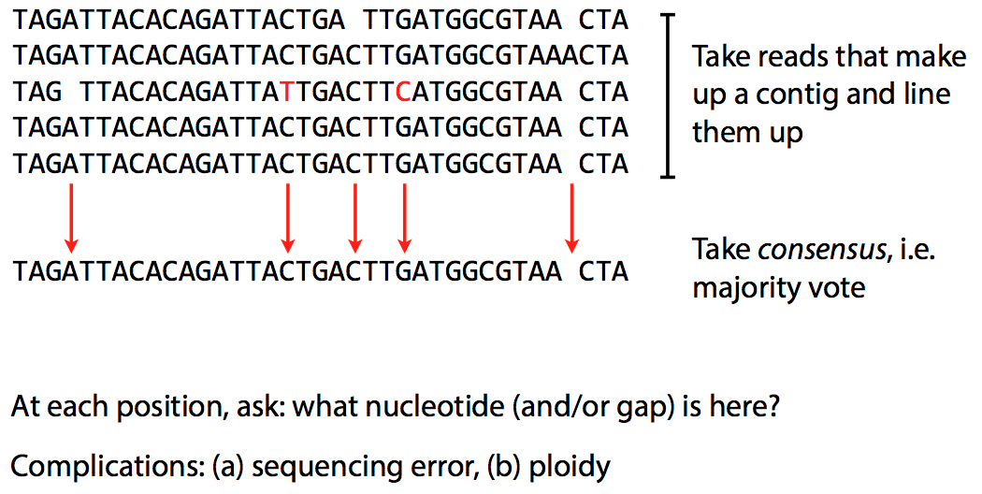
Overlap-Layout- Consensus: OLC
Consensus
http://www.cs.jhu.edu/~langmea/resources/lecture_notes/assembly_olc.pdf

Slide 55
Overlap-Layout- Consensus: Drawbacks
Ovelap step is very time consuming
Overlap graph is large, you need one node per read (consider sequencing errors) and the number of edges grows faster than the number of nodes
Not practical when you have hundreds of millions of reads, i.e., Illumina. But, good with datasets of long reads (e.g., Celera Assembler)
http://www.cs.jhu.edu/~langmea/resources/lecture_notes/assembly_olc.pdf

Slide 56
Overlap-Layout- Consensus: Software
Software | Year | Reference | Download
ARACHNE | 2002 | Genome Res. 2002. 12: 177-189 | http://www.genome.wi.mit.edu
PHRAP | 1994 | http://www.phrap.org/phredphrap/phrap.html | http://www.phrap.org/
CAP | 1999 | Genome Res. 1999. 9: 868-877 | http://seq.cs.iastate.edu/
TIGR | 1995 | Genome Sci Tech. 1995. 1:9-19 | http://www.jcvi.org/
CELERA | 2000 | Science. 2000. 287:2196-2204 | http://wgs-assembler.sourceforge.net
Newbler | 2005 | Nature. 2005. 437:376-380 | http://www.454.com/products/analysis-software/

Slide 57
k-mers
k-mers are strings, of length k, of characters from a defined alphabet.
Given the set of reads:
R={TACAGT, CAGTC, AGTCA, CAGA}
Answer
How many k-mers are in these reads (including duplicates), for k=3?
How many distinct k-mers are in these reads?
For k=2
For k=3
For k=5
It appears that these reads come form the toy genome TACAGTCAGA. What is the largest k such that the set of distinct k-mers in the genome is exactly the set of distinct k-mers in the reads?
For any value of k, is there a mathematical relationship between N, the number of k-mers (incl. duplicates) in a sequence, and L, the length of the sequence?
Notes:
http://evomicsorg.wpengine.netdna-cdn.com/wp-content/uploads/2015/01/2015-evomics-assembly.pdf
12
A.7, B.7, C.4
3. When k=4, the kmer TCGA does not appear in the reads
N=L-k+1

Slide 58
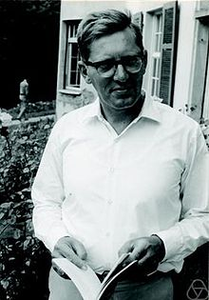
De Bruijn graphs
Nicolas de Bruijn
The Problem: find a shortest circular “superstring” that contains all possible “substrings” of length k (k-mers) over a given alphabet.
(1918 –2012)
Netherlands
How many k-mers of length k exist over an alphabet of length n?
Build a graph, where every possible (k-1)-mer is a node
Draw an edge between two nodes if there is a k-mer whose prefix is the first node and suffix is the second node
Example: Find the shortest circular superstring that contains all k-mer of length 4 on a binary alphabet
Compeau et al., 2011. http://www.nature.com/nbt/journal/v29/n11/pdf/nbt.2023.pdf
https://en.wikipedia.org/wiki/Nicolaas_Govert_de_Bruijn

Slide 59
De Bruijn graphs
Build a graph, where every possible (k-1)-mer is a node
Draw an edge between two nodes if there is a k-mer whose prefix is the first node and suffix is the second node
How many 4-mers exist over an alphabet of length 2?
2⁴=16
1. Create all k-1 nodes (how many?)
2. Draw edges
0011
3
001
011
Shortest superstring containing all 4-mers:
0000110010111101
Eulerian cycle
0010
1011
Find the shortest superstring that contains all k-mer of length 4 on a binary alphabet
7
9
2
0001
1010
0111
10
0000
14
1111
000
1
010
101
11
111
4
0110
All possible 4-mers
1001
6
1 | 0000 | 9 | 1011
2 | 0001 | 10 | 0111
3 | 0011 | 11 | 1111
4 | 0110 | 12 | 1110
5 | 1100 | 13 | 1101
6 | 1001 | 14 | 1010
7 | 0010 | 15 | 0100
8 | 0101 | 16 | 1111
8
1 | 0000 | 9 | 1011
2 | 0001 | 10 | 0111
3 | 0011 | 11 | 1111
4 | 0110 | 12 | 1110
5 | 1100 | 13 | 1101
6 | 1001 | 14 | 1010
7 | 0010 | 15 | 0100
8 | 0101 | 16 | 1111
1000
1110
12
16
15
0101
13
100
0100
1101
110
5
0011
Compeau et al., 2011. http://www.nature.com/nbt/journal/v29/n11/pdf/nbt.2023.pdf
https://en.wikipedia.org/wiki/Nicolaas_Govert_de_Bruijn

Slide 60
De Bruijn graphs
The edges in the de Bruijn graph represent all possible k-mers
0011
3
001
1011
011
0010
7
9
2
0001
1010
0111
10
0000
14
1111
000
1
010
101
11
111
4
0110
1001
6
8
1000
0101
1110
12
16
15
13
100
0100
1101
110
5
0011
Compeau et al., 2011. http://www.nature.com/nbt/journal/v29/n11/pdf/nbt.2023.pdf
https://en.wikipedia.org/wiki/Nicolaas_Govert_de_Bruijn

Slide 61
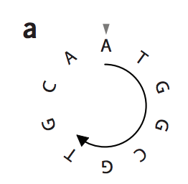
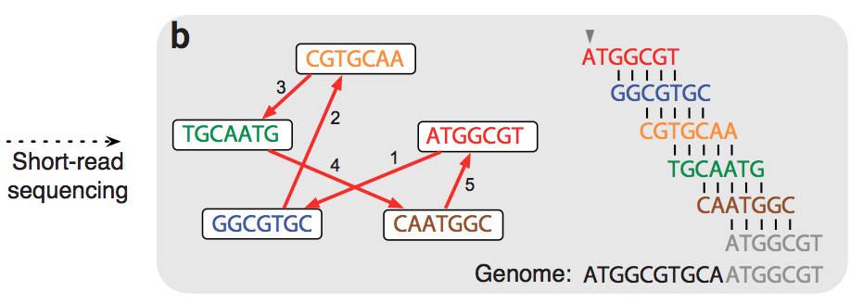
Graphs for genome assembly
Ovelap Graph
But computing read overlaps is very costly
Compeau et al., 2011. http://www.nature.com/nbt/journal/v29/n11/pdf/nbt.2023.pdf

Slide 62
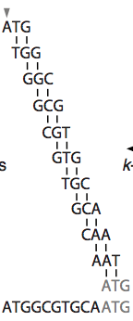
Graphs for genome assembly
Then, split the reads as k-mers (sub-strings of length k)
Now, you have two options: 1.- Let the k-mers be nodes in the graph
k=3
k-mer graph
Draw edges based on pairwise alignments
Reads
ATG
AAT
TGG
ATGGCGT
GGCGTGC
CAA
GGC
Look for a hamiltonian cycle: Visit each vertex once
(hard to solve)
CGTGCAA
TGCAATG
GCA
GCG
CAATGGC
TGC
CGT
Genome:
Compeau et al., 2011. http://www.nature.com/nbt/journal/v29/n11/pdf/nbt.2023.pdf
GTG

Slide 63
De Bruijn graphs for genome assembly
Then, split the reads as k-mers (sub-strings of length k)
2.- Let the k-mers-1 be nodes in the graph, i.e., suffixes and prefixes
k=3
k-mer-1 graph
Reads
Edges represent k-mers having a particular suffix and prefix
AAT
AT
ATG
ATGGCGT
AA
TG
GGCGTGC
CAA
TGG
CGTGCAA
Look for an Eulerian cycle: Visit each edge once
(easier to solve)
GTG
TGC
TGCAATG
CA
GG
CAATGGC
GCA
GGC
GT
GC
Genome:
CGT
CG
GCG
Compeau et al., 2011. http://www.nature.com/nbt/journal/v29/n11/pdf/nbt.2023.pdf
Notes:
“A graph in which indegrees are equal to outdegrees for all nodes is called ‘balanced’. Euler’s theorem states that a connected directed graph has an Eulerian cycle if and only if it is balanced. In particular, Euler’s theorem implies that our de Bruijn graph contains an Eulerian cycle as long as we have located all k-mers present in the genome. “

Slide 64
De Bruijn graph: Assumptions so far
All k-mers present in the genome are available
K-mers are error free
Each k-mer appear at most once in the genome
The genome is a single circular chromosome
Does not apply in NGS datasets!
1. Generating (nearly) all k-mers present in the genome
Reads of length k, only capture a small fraction of the k-mers from the genome, e.g., due to difficulties in sequencing some genomic regions.
For the genome sequence: ATGGCGTGCA
Do the reads represent all the 7-mers from the genome?
What happens if brake your reads into 3-mers?
Reads:
ATGGCGT
GGCGTGC
CGTGCAA
TGCAATG
CAATGGC
That is why we do not use k = length of the read. When using k-mers smaller than the read length, the resulting k-mers represent nearly all the k-mers in the genome.
Compeau et al., 2011. http://www.nature.com/nbt/journal/v29/n11/pdf/nbt.2023.pdf
Notes:
All the 3-mers available in the genome ATGGCGTGCA are available in the reads

Slide 65
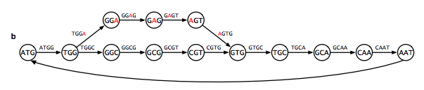
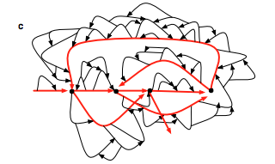
De Bruijn graph: Assumptions so far
All k-mers present in the genome are available
K-mers are error free
Each k-mer appear at most once in the genome
The genome is a single circular chromosome
Does not apply in NGS datasets!
2. Handling errors in reads.
Errors create bulges in the de Bruijn graph. The same happens with in-exact repeats or polymorphisms
Deal with the bulges, different packages deal in different ways. As an alternative, error-correct the reads prior to the assembly.
A single sequencing error, creates a bulge and increases the size of the graph
Compeau et al., 2011. http://www.nature.com/nbt/journal/v29/n11/pdf/nbt.2023.pdf
Notes:
All the 3-mers available in the genome ATGGCGTGCA are available in the reads

Slide 66
De Bruijn graph: Assumptions so far
All k-mers present in the genome are available
K-mers are error free
Each k-mer appear at most once in the genome
The genome is a single circular chromosome
Does not apply in NGS datasets!
3. Handling DNA repeats.
Let’s have the cyclic genome ATGCATGC
And the 3-mer reads: ATG, TGC, GCA, CAT
Obtain the genome sequence from the reads using de Bruijn graphs, with a k=3!
Check whether all k-mers in the genome are available?
Compeau et al., 2011. http://www.nature.com/nbt/journal/v29/n11/pdf/nbt.2023.pdf
Notes:
All the 3-mers available in the genome ATGGCGTGCA are available in the reads

Slide 67
De Bruijn graph: Assumptions so far
All k-mers present in the genome are available
K-mers are error free
Each k-mer appear at most once in the genome
The genome is a single circular chromosome
Does not apply in NGS datasets!
3. Handling DNA repeats.
Let’s have the cyclic genome ATGCATGC
And the 3-mer reads: ATG, TGC, GCA, CAT
One solution, will be to record how many times each k-mer appears (m=k-mer multiplicity), drawing m edges between its suffix and prefix
Obtain the genome sequence from the reads using de Bruijn graphs, with a k=3, and assuming k-mer multiplicity = 2
Compeau et al., 2011. http://www.nature.com/nbt/journal/v29/n11/pdf/nbt.2023.pdf
Notes:
All the 3-mers available in the genome ATGGCGTGCA are available in the reads

Slide 68
De Bruijn graph: Assumptions so far
All k-mers present in the genome are available
K-mers are error free
Each k-mer appear at most once in the genome
The genome is a single circular chromosome
Does not apply in NGS datasets!
3. Handling DNA repeats.
Let’s have the cyclic genome ATGCATGC
And the 3-mer reads: ATG, TGC, GCA, CAT
One solution, will be to record how many times each k-mer appears (m=k-mer multiplicity), drawing m edges between its suffix and prefix
With current data, instead of relying on multiplicity, the best approach is to exploit paired-end reads. How?
Compeau et al., 2011. http://www.nature.com/nbt/journal/v29/n11/pdf/nbt.2023.pdf
Notes:
All the 3-mers available in the genome ATGGCGTGCA are available in the reads

Slide 69
De Bruijn graph: Assumptions so far
All k-mers present in the genome are available
K-mers are error free
Each k-mer appear at most once in the genome
The genome is a single circular chromosome
Does not apply in NGS datasets!
4. Handling multiple and linear chromosomes.
Single linear chromosome: Look for an Eulerian path instead of an Eulerian cycle. Visit each edge, but no need to finish in the starting node.
Several linear chromosome: Search for multiple Eulerian paths, each would be a “chromosome”
Compeau et al., 2011. http://www.nature.com/nbt/journal/v29/n11/pdf/nbt.2023.pdf
Notes:
All the 3-mers available in the genome ATGGCGTGCA are available in the reads

Slide 70
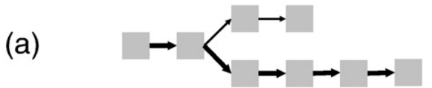
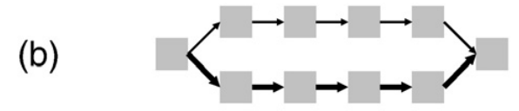
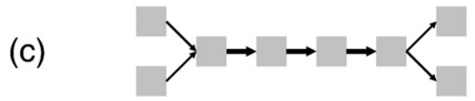
Review of graph complexity
Thickness of edges represents multiplicity
Low frequency dead-ends: Reads with sequencing errors towards the end
Bulges, due to sequencing errors or polymorphisms toward the middle of the reads
Collapsed paths, due to near identical repeats.
Miller et al., 2010. http://www.sciencedirect.com/science/article/pii/S0888754310000492

Slide 71
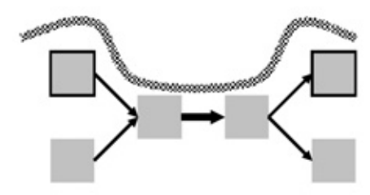
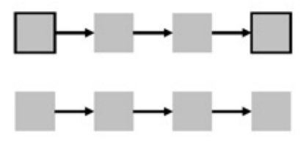
Some methods to resolve graph complexity
Thickness of edges represents multiplicity
Collapsed repeat, repeat length shorter than read length
Which path to follow?
Read
Miller et al., 2010. http://www.sciencedirect.com/science/article/pii/S0888754310000492

Slide 72
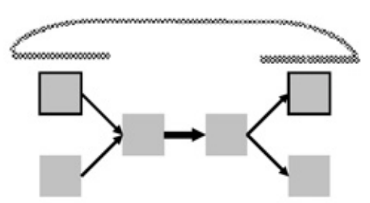
Some methods to resolve graph complexity
Thickness of edges represents multiplicity
Collapsed repeat, repeat length shorter than paired-end distances (insert sizes)
R1
R2
Miller et al., 2010. http://www.sciencedirect.com/science/article/pii/S0888754310000492

Slide 73
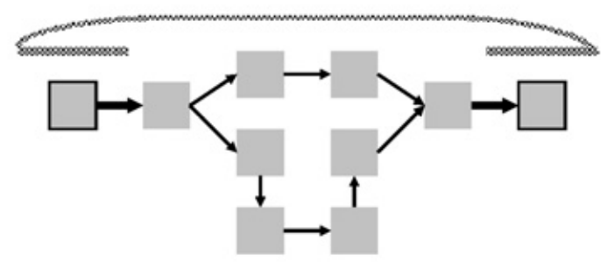
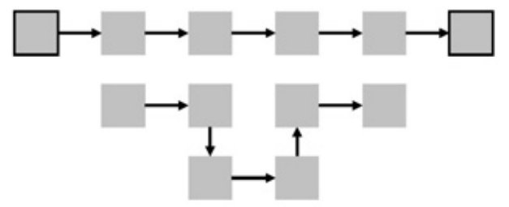
Some methods to resolve graph complexity
Thickness of edges represents multiplicity
Bulge/bubble, due to sequencing errors or polymorphisms
Following paired-end/mate-pair constraints
Miller et al., 2010. http://www.sciencedirect.com/science/article/pii/S0888754310000492

Slide 74
De Bruijn graph assemblers: Software
Software | Year | Reference | Download
Euler | 2001 | PNAS. 2001. 98:9748-9753 | http://cseweb.ucsd.edu/~ppevzner/software.html
Velvet | 2007 | Genome Res. 2008. 18:821-829 | https://www.ebi.ac.uk/~zerbino/velvet/
AllPaths | 2010 | PNAS. 2011. 108:1513-1518 | http://www.broadinstitute.org/software/allpaths-lg/
SPAdes | 1995 | J Comput Biol. 2012. 19:455-477 | http://bioinf.spbau.ru/spades
IDBA | 2010 | RECOMB. 2010 | http://i.cs.hku.hk/~alse/idba/
Trinity (Transcriptomics) | 2011 | Nat Biotechnol. 2011. 29:644-652 | http://trinityrnaseq.github.io/

Slide 75
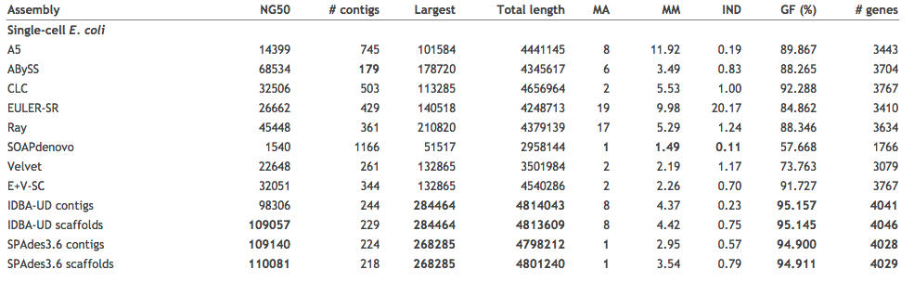
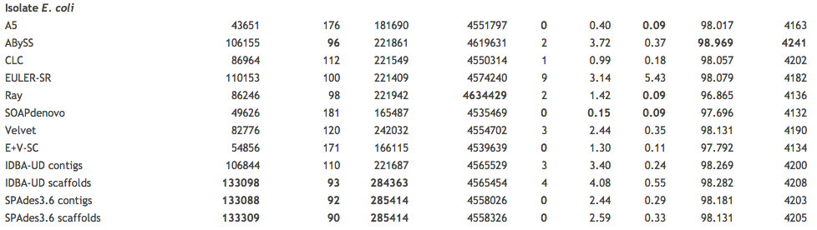
Comparing assemblers
http://bioinf.spbau.ru/spades
indels
Mis-assemblies
Mismatch
error rate
Genome
Fraction
Notes:
The percentage of the E. coli and S. aureus genomes covered filters out these issues (GF (%), Genome fraction (%) column). The NG50 statistic is the same as the N50 except that the genome size is used rather than the assembly size. Misassemblies (MA) are locations on an assembled contig where the left flanking sequence aligns over 1 kb away from the right flanking sequence on the reference. Mismatch (substitution) error rate (MM) and number of indels (IND) per 100 kbp are measured in aligned regions of the contigs. In each column, the best assemblers by that criteria is indicated in bold.

Slide 76
Selecting the best k-mer for assembly
The quality of the assembly strongly depends on the value of k-mer for de Bruijn graph assemblers
The ideal k-mer depends on:
Sequencing coverage
Sequencing error rate
Genome complexity
Too small k: the assembly fragments in repeats longer than k
Too large k: higher chances that the k-mer will have errors, bulges/bubbles

Slide 77
Selecting the k-mer: Velvet Optimizer
Run velvet for a collection of k-mer values: k_{i}<K<k_{j}
Pick the assembly that is best at some metric, e.g., N50, total length, number of contigs.
Very simple strategy, but very time consuming. We will use a manual version of this in the practical session.

Slide 78
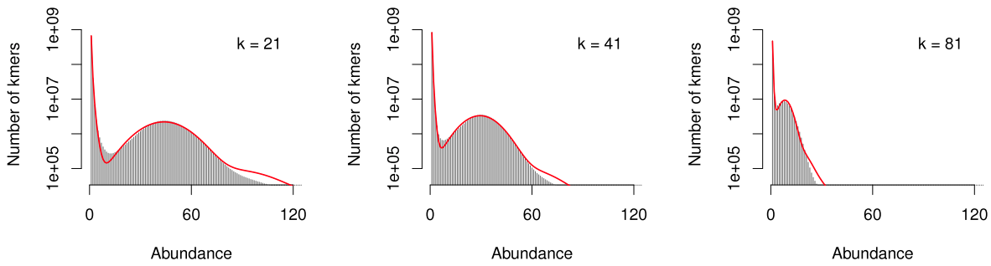
Selecting the k-mer:KMERGENIE
A fast and efficient way to compute best k-mer for a de Bruijn assembly
1. Compute multiplicity histogram, for various values of k
Number of distinct k-mers with multiplicity 60
Noise
Signal
2. Estimate the number of genomic k-mers (signal)
3. The best k for assembly is the one which provides the most distinct genomic k-mers.
http://kmergenie.bx.psu.edu/
Chikhi & Medvedev. 2014. http://bioinformatics.oxfordjournals.org/content/30/1/31

Slide 79
Comparing assemblers
Development of software for genome assembly is a very dynamic area, and this is related to the continuous changes in the sequencing technologies,
For you project, it is always advisable to use more than a single assembler, and then compare results, or even merge results
A good starting point, is to check the results of comparison of different assemblers:
GAGE: http://gage.cbcb.umd.edu/
Assemblathon: http://assemblathon.org/

Slide 80



Sequence and annotation of genomes and metagenomes with Galaxy
Genome annotation
Dr. rer. nat. Diego Mauricio Riaño Pachón
Brazilian Bioethanol Science and Technology Laboratory (CTBE)
Brazilian Center for Research in energy and Materials (CNPEM)
diego.riano@bioetanol.org.br
http://bce.bioetanol.cnpem.br

Slide 81
Genome annotation

Slide 82


What is Genome Annotation?
Stein, 2001. http://www.nature.com/nrg/journal/v2/n7/full/nrg0701_493a.html

Slide 83

What is Genome Annotation?
Yandell & Ence, 2012. http://www.nature.com/nrg/journal/v13/n5/full/nrg3174.html

Slide 84

What is Genome Annotation?
Yandell & Ence, 2012. http://www.nature.com/nrg/journal/v13/n5/full/nrg3174.html
Notes:
Approaches are compared on the basis of relative time, effort and the degree to which they rely on external evidence, as opposed to ab initio gene models. The y axis shows increasing time and effort; the x axis shows increasing use of external evidence and, consequently, increasing accuracy and completeness of the resulting gene models. The type of final product produced by each kind of pipeline is shown in the dark blue boxes. Relative positions in the figure are for summary purposes only and are not based on precisely computed values. See TABLE 1 for a list of commonly used software components. CDS, coding sequence; EST, expressed sequence tag; RNA-seq, RNA sequencing; UTR, untranslated region

Slide 85

NCBI Prokaryotic Genome Annotation Process
http://www.ncbi.nlm.nih.gov/genome/annotation_prok/process/

Slide 86


Models
Stein, 2001. http://img.jgi.doe.gov/edu/doc/genome-annotation-2001.pdf

Slide 87
Prodigal Pseudocode
Hyatt et al., 2010. http://www.biomedcentral.com/1471-2105/11/119

Slide 88
END
Part III

